Slide 1
Unlock the FoundationDB Record Layer:
Language Flexibility
and Network Freedom with a gRPC Microservice
James Krepelka
Notes:
Introduce yourself
State the title of your research paper

Slide 2
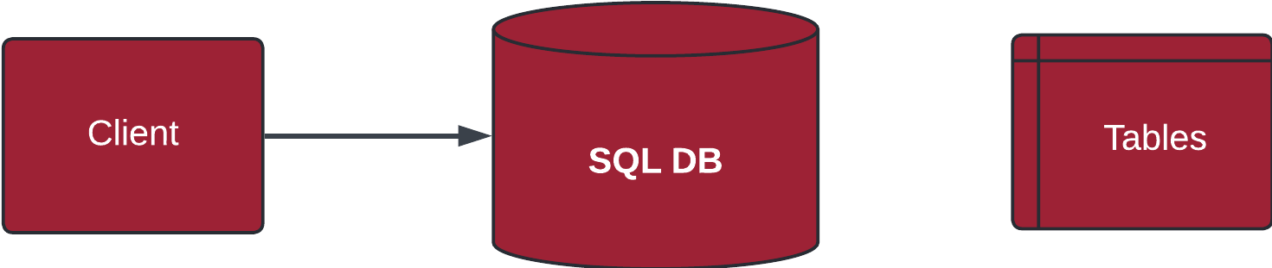


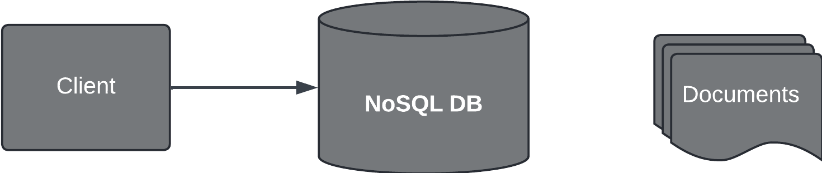
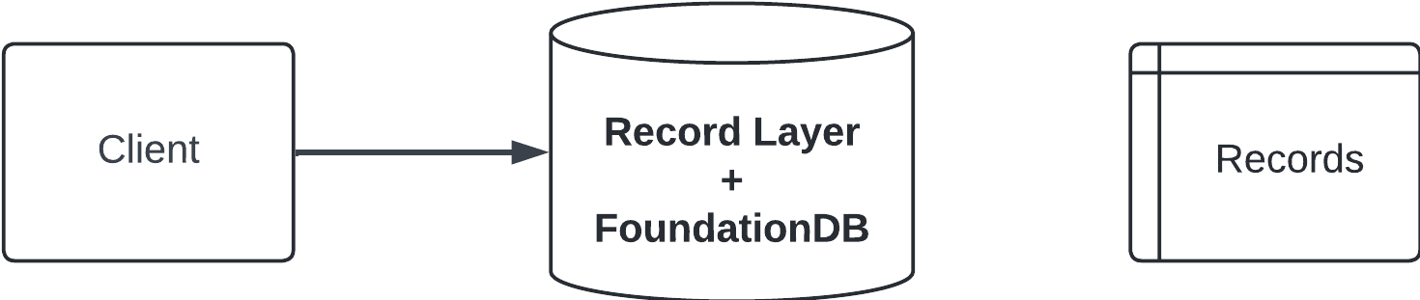
Background
Horizontally Scalable
Simple Data Consistency
Horizontally Scalable
Simple Data Consistency
Horizontally Scalable
Simple Data Consistency
Notes:
Traditional SQL databases, while powerful, faced scalability challenges in the era of Web 2.0.
This led to NoSQL solutions that prioritized scalability, often sacrificing ACID guarantees familiar to SQL developers.
To bridge this gap, NewSQL technologies like FoundationDB offer scalable, distributed storage with ACID compliance. FoundationDB's layered architecture allows flexibility, with its Record Layer providing a record-oriented data model similar to relational databases.

Slide 3
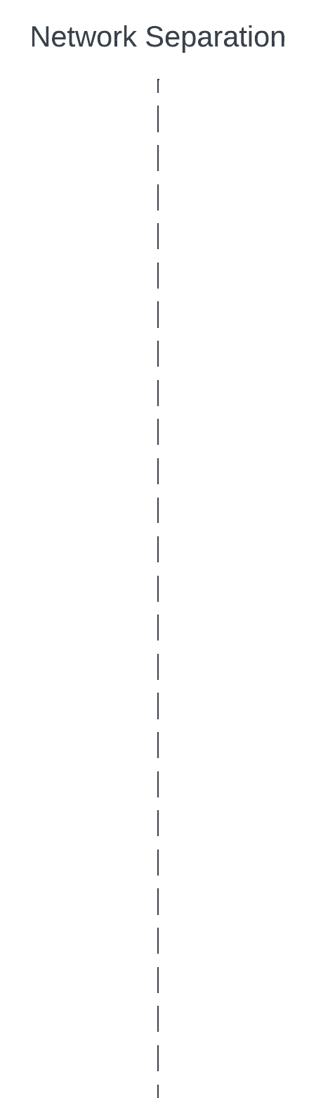
Background
Horizontally Scalable
Simple Data Consistency
Horizontally Scalable
Simple Data Consistency
Horizontally Scalable
Java Only
Simple Data Consistency
Notes:
However, the Record Layer's Java-only implementation and network co-location requirement limit its wider adoption.
This research explores how encapsulating the Record Layer within a microservice could enhance its accessibility and deployment flexibility, aiming to address these limitations without compromising performance

Slide 4
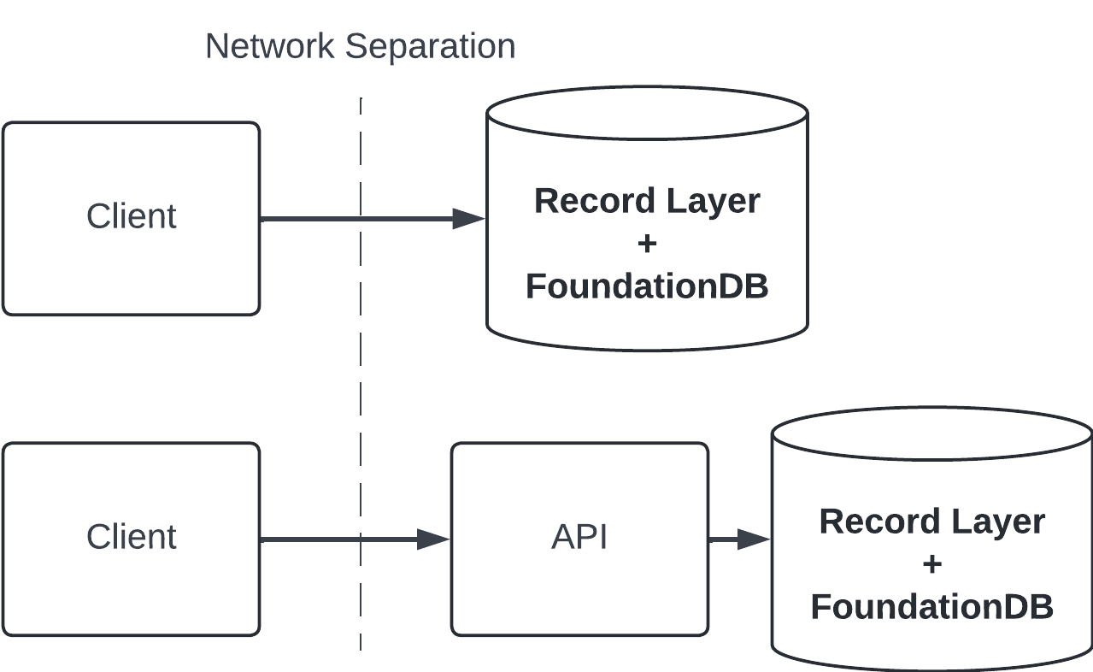
Problem Statement
"Unlocking" the FoundationDB Record Layer
This research works to show that encapsulating the Record Layer within a microservice could enhance its accessibility and deployment flexibility, without compromising performance.
From:
Java Only
To:
Notes:
Add important points here

Slide 5
Research Methodology
Development:
Created a benchmark application directly utilizing the FoundationDB Record Layer.
Developed a functionally equivalent application interacting with the Record Layer via a gRPC microservice.
Experiment Design:
Defined a suite of read and write operations with varying data sizes.
Established performance metrics (latency).
Evaluation:
Executed the benchmark applications against a FoundationDB cluster, measuring performance metrics for both the direct Record Layer and gRPC-based approaches.
Analyzed results to quantify the overhead introduced by the gRPC microservice layer across different workloads.
Notes:
Add important points here

Slide 6
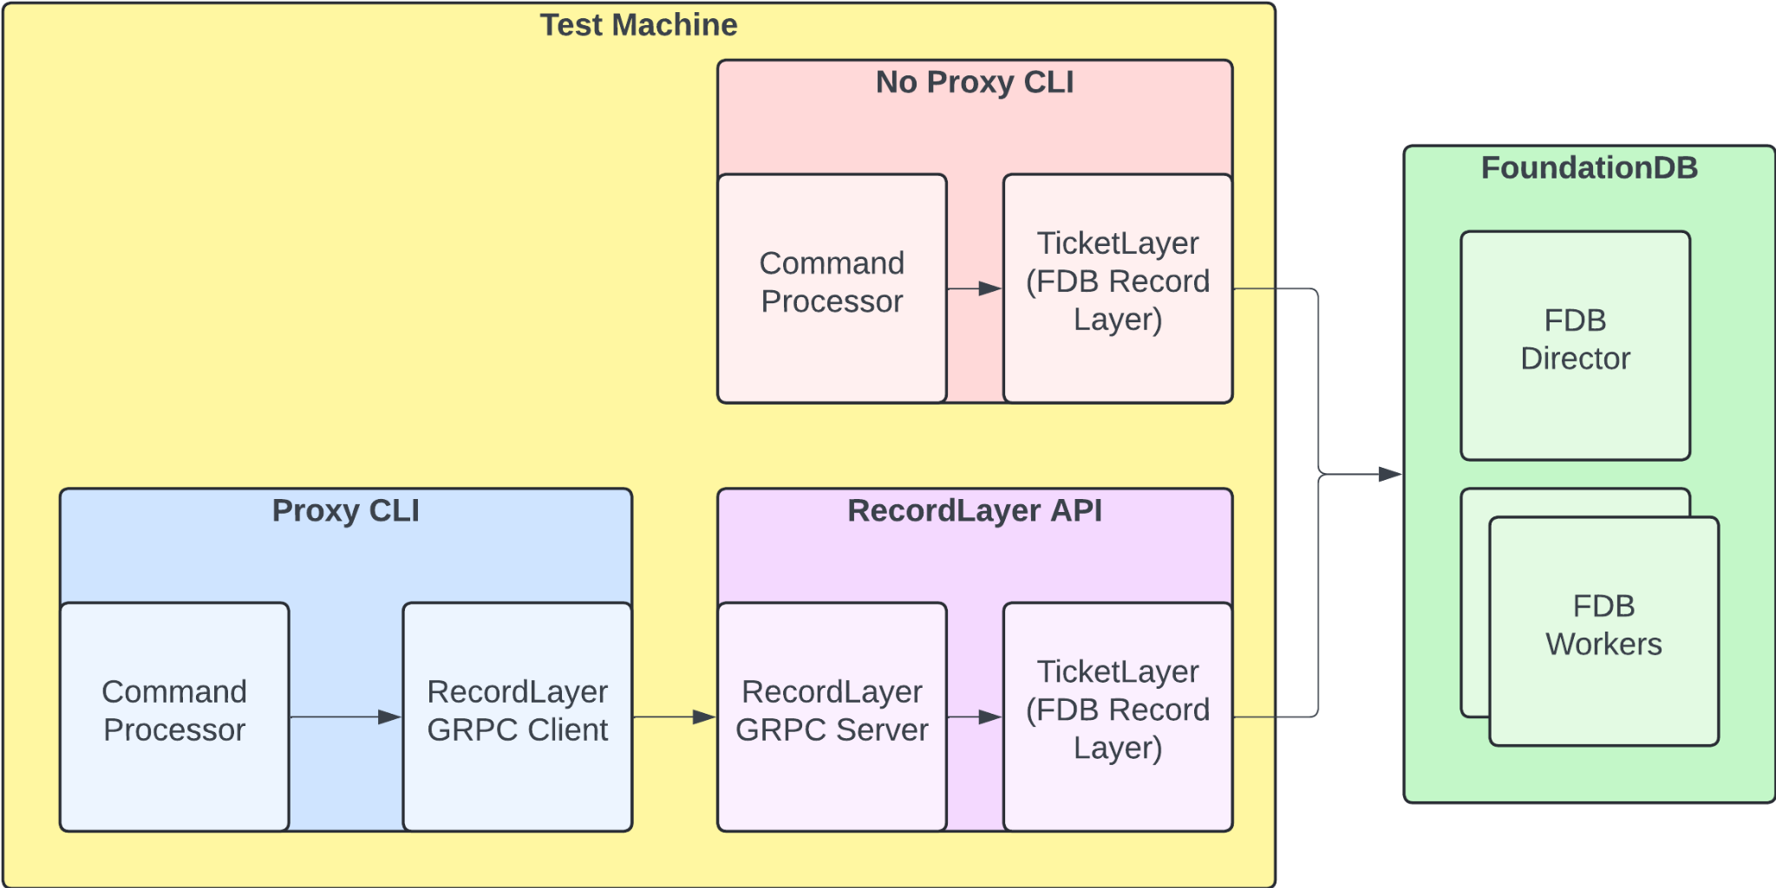
Research Methodology - System Design
Notes:
Add important points here

Slide 7
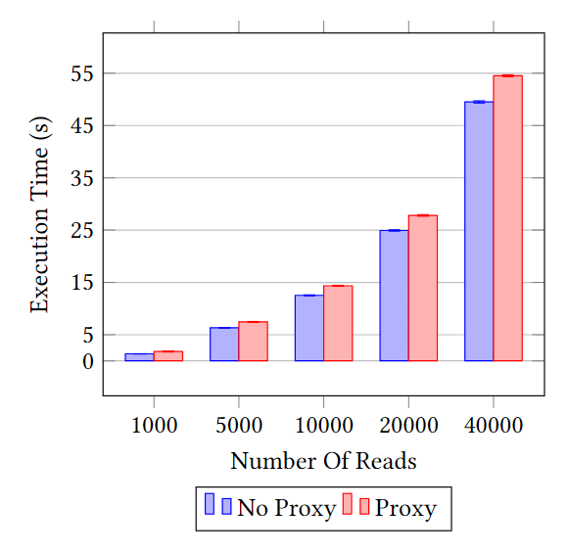
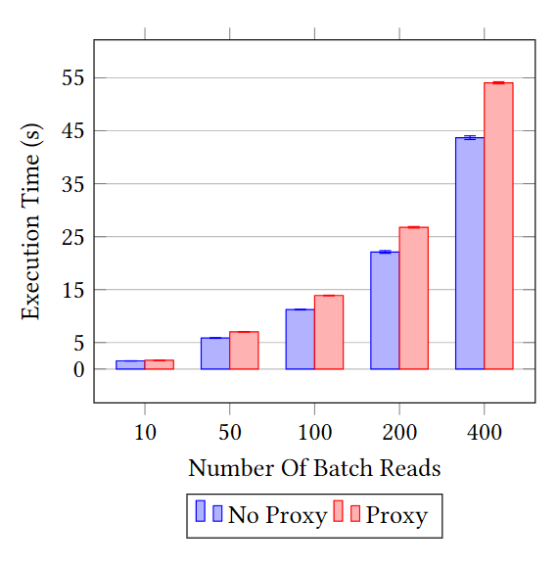

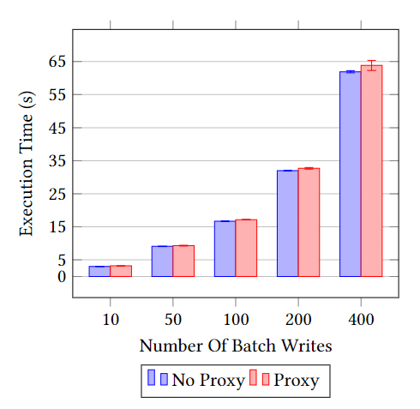
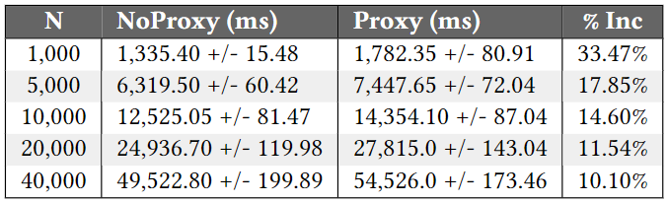
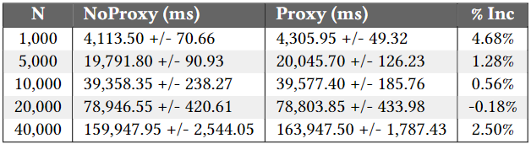
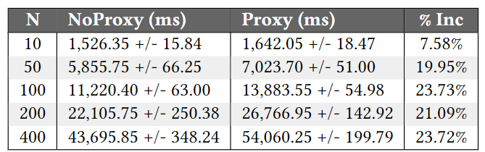
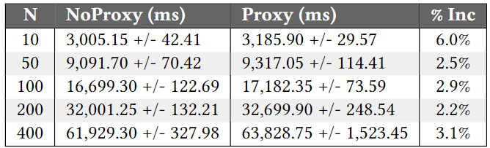
Results and Findings
< Single Writes
v Large Batch Writes
^ Single Random Reads
Large Batch Reads >
Notes:
Add important points here

Slide 8
Summary and Conclusions
This research demonstrates that a gRPC microservice wrapper for the FoundationDB Record Layer introduces likely acceptable performance overheads.
This gRPC approach addresses language limitations with minimal impact, particularly in write-heavy scenarios (1-6% latency increase).
Furthermore, by handling direct FoundationDB connections within a horizontally scalable microservice, this approach overcomes network co-location restrictions. This empowers organizations to adopt FoundationDB's open-source NewSQL capabilities within modern security-conscious architectures, making the Record Layer a more compelling data storage solution across a wider range of applications.
Notes:
Add important points here

Slide 9
Any Questions?
Notes:
Remember to stop the timer when it goes off.
Ask the audience if there are any questions.

Slide 10
Thank You
Notes:
Remember to stop the timer when it goes off.
Ask the audience if there are any questions.

